Slide 1
ARCHITECTURE OF 8086

Slide 2
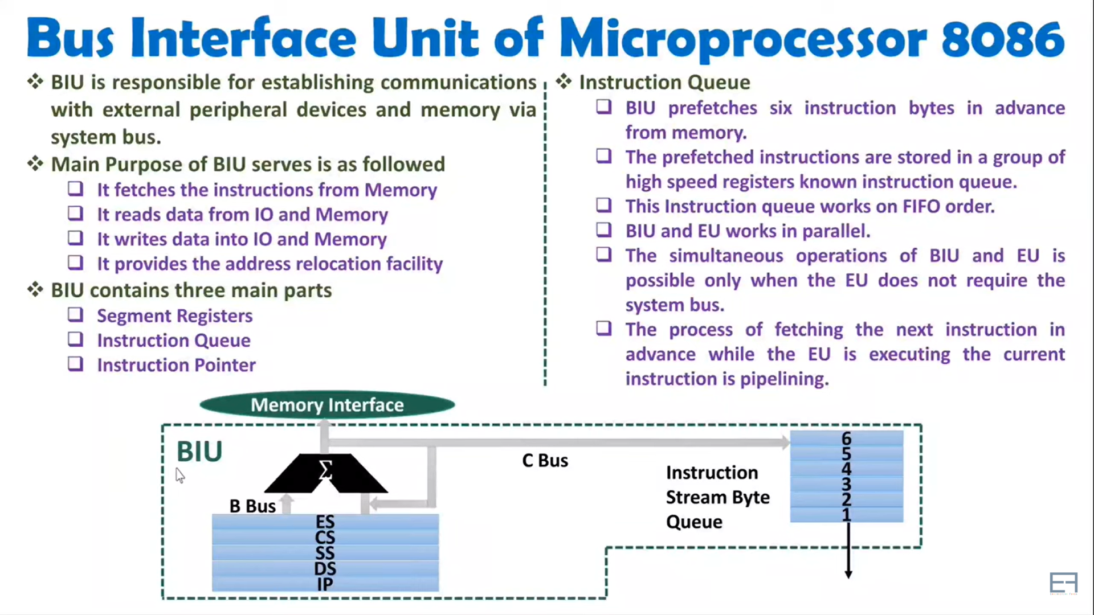

Slide 3
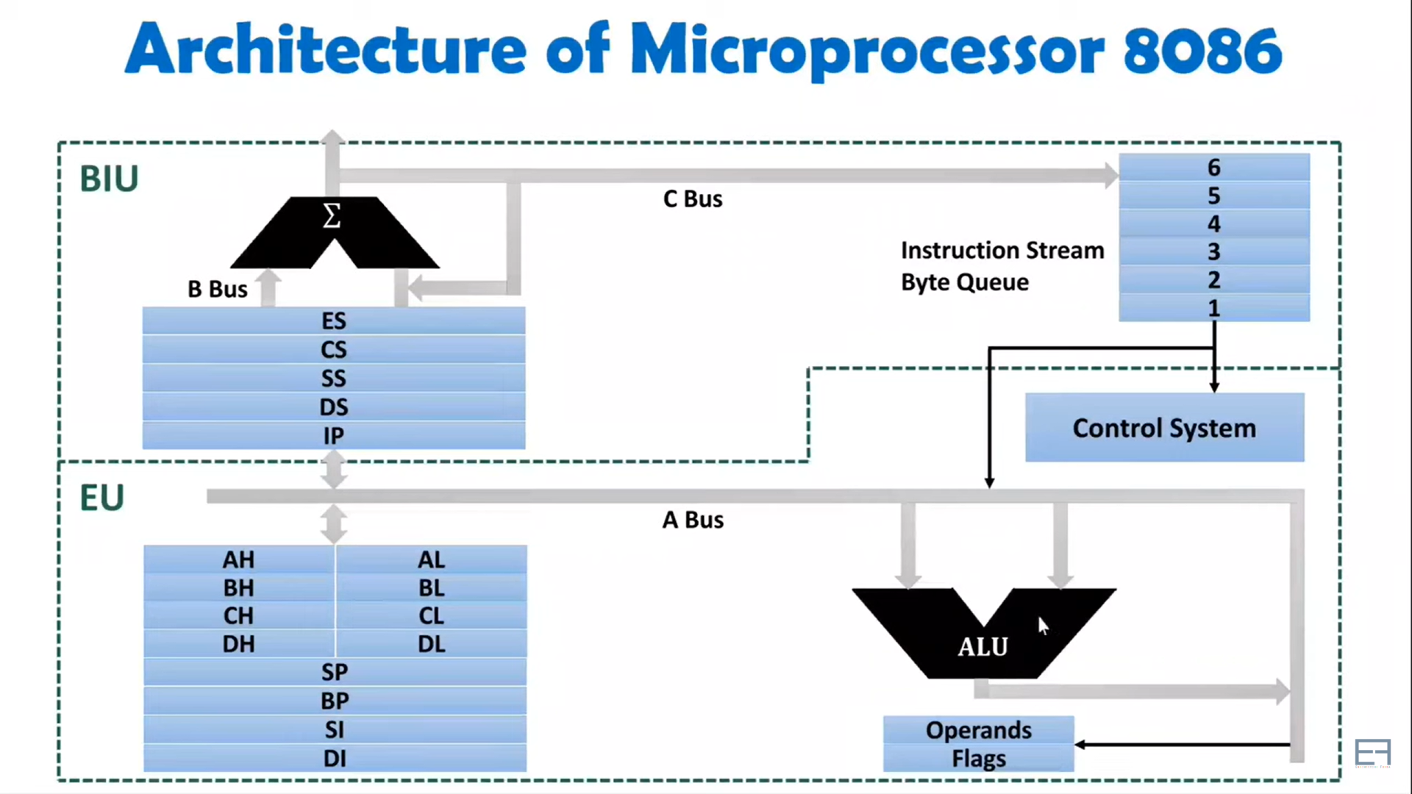

Slide 4
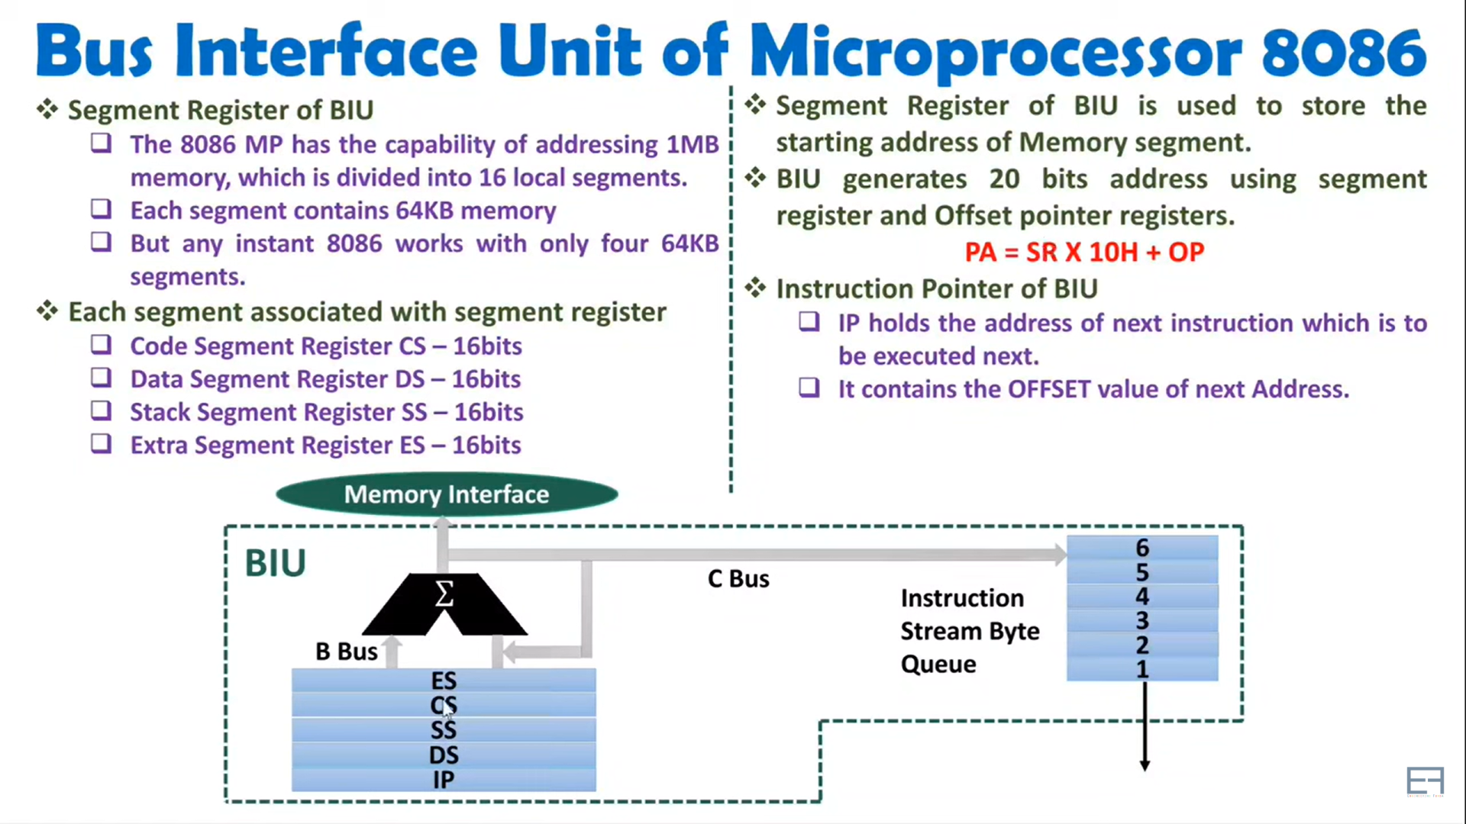

Slide 5
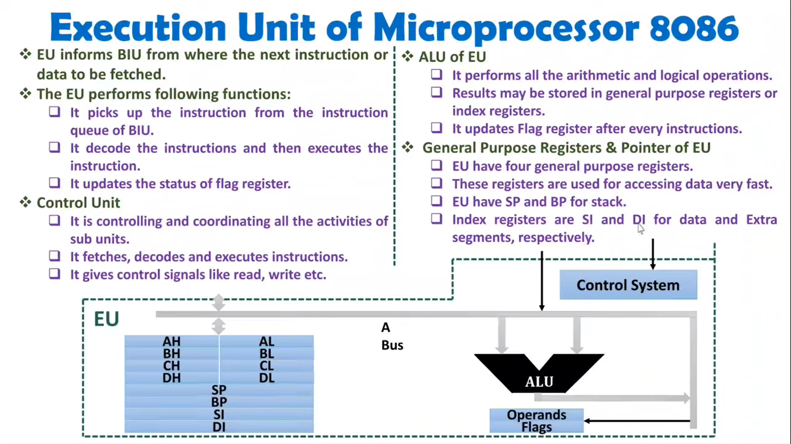

Slide 6
ADDRESSING MODES

Slide 7
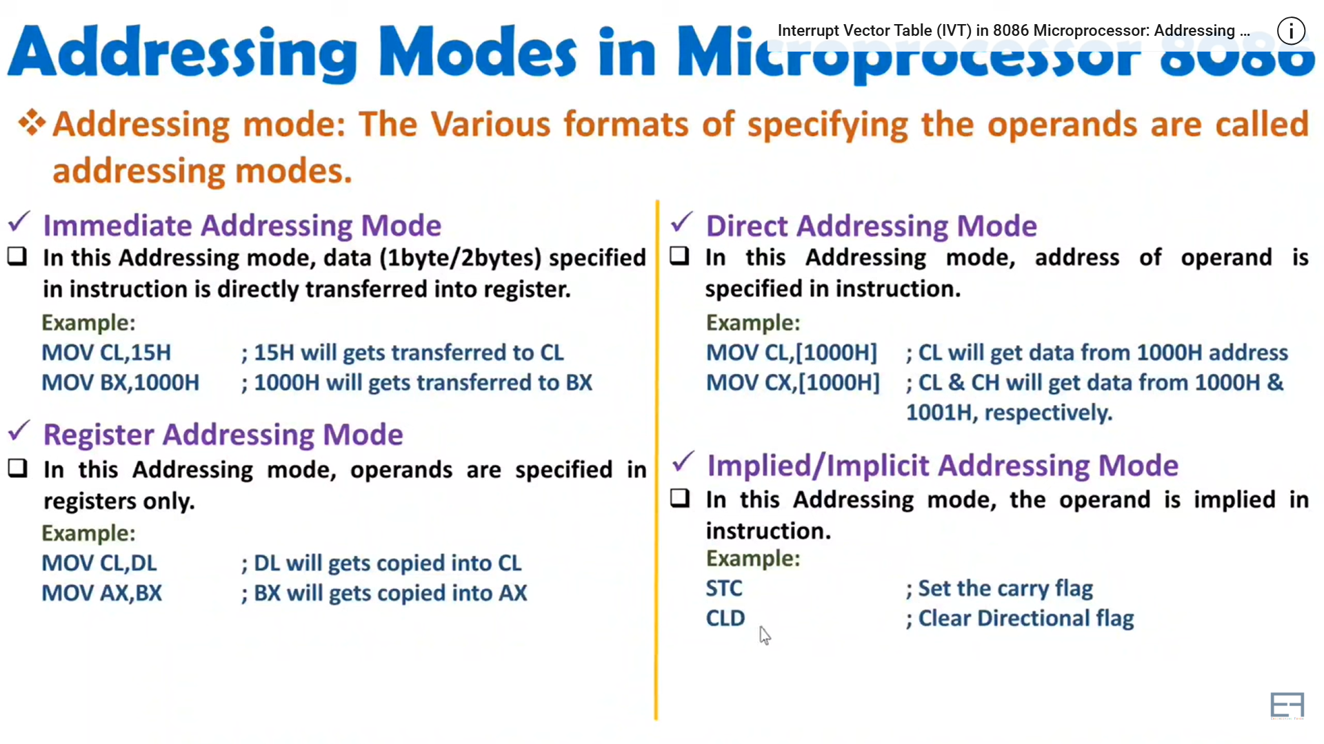

Slide 8
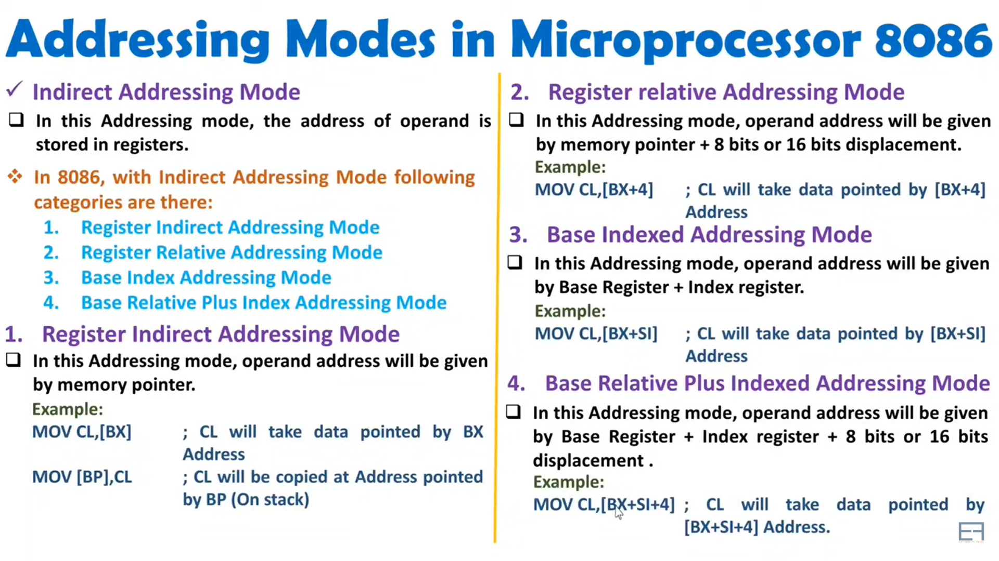

Slide 9
MINIMUM MODE AND TIMING DIAGRAM

Slide 10
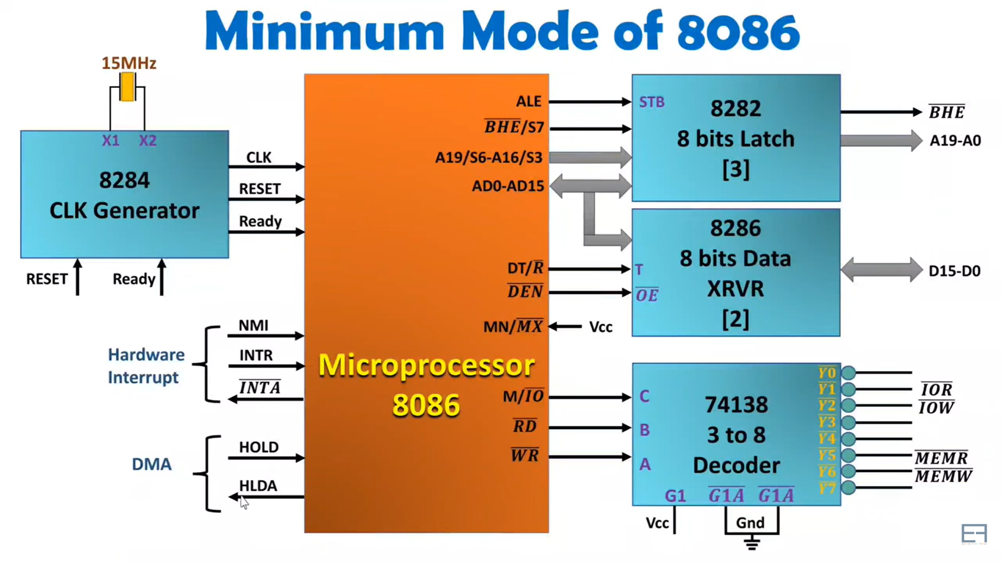

Slide 11
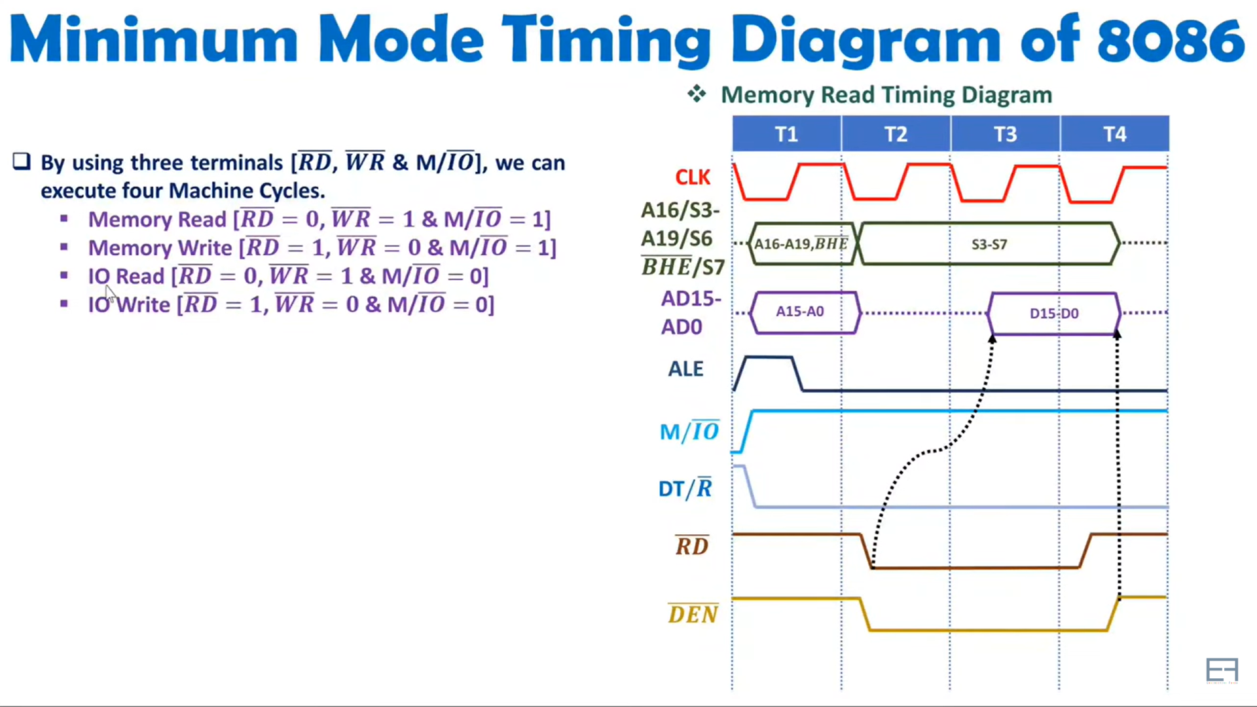

Slide 12
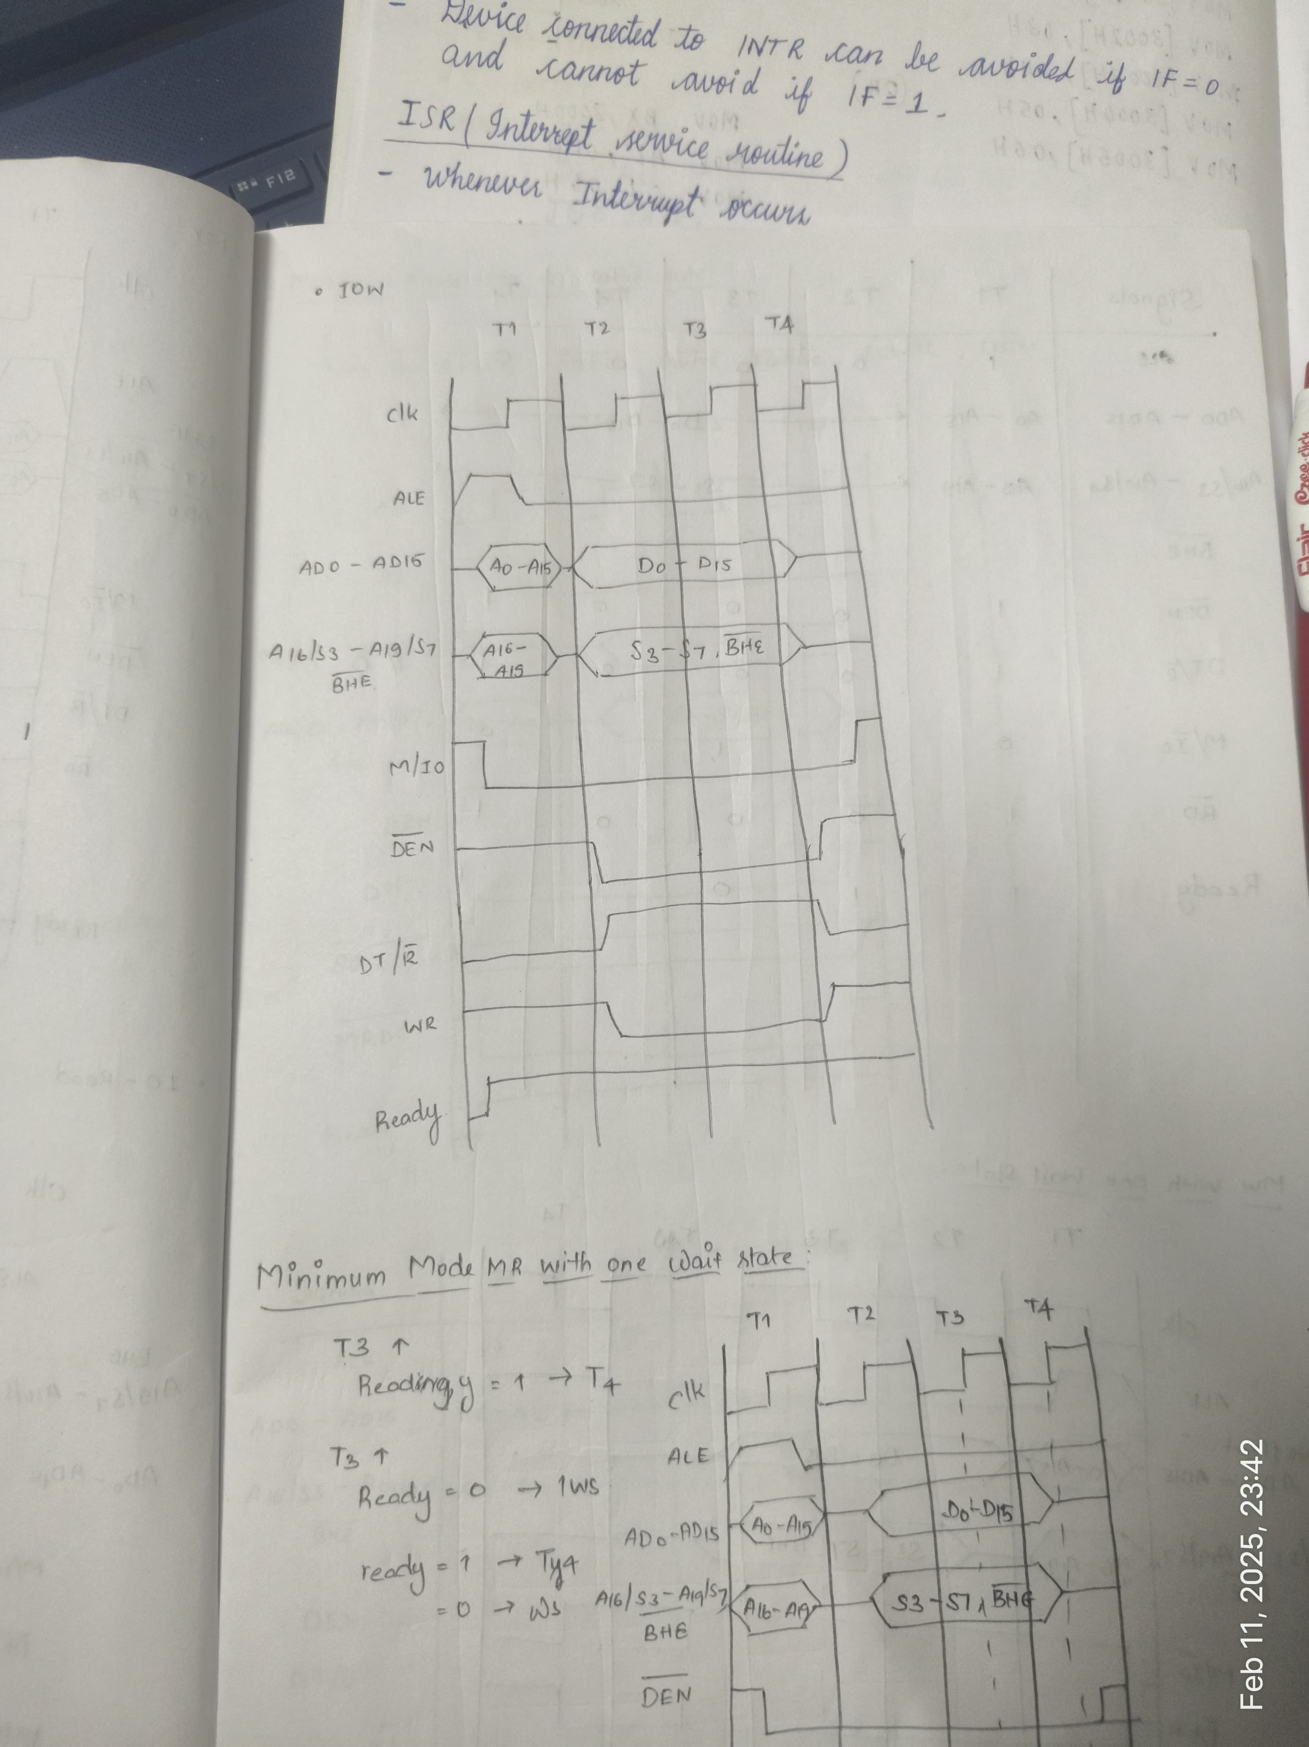
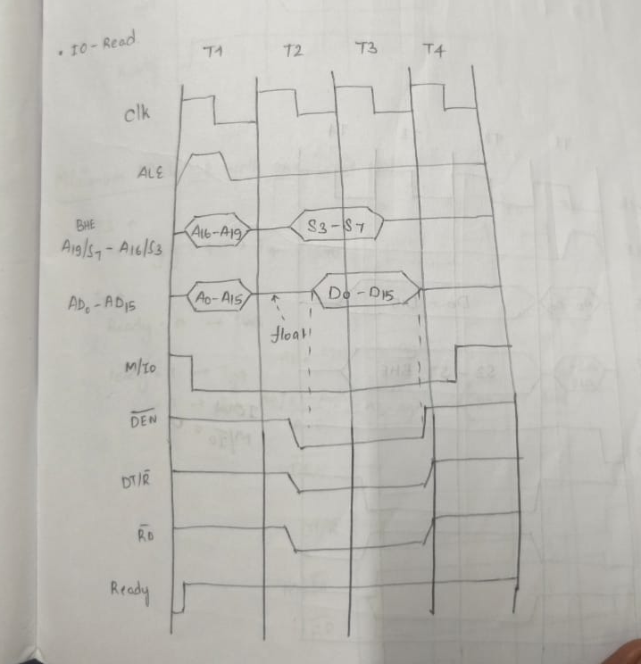
I/O WRITE
I/O READ

Slide 13
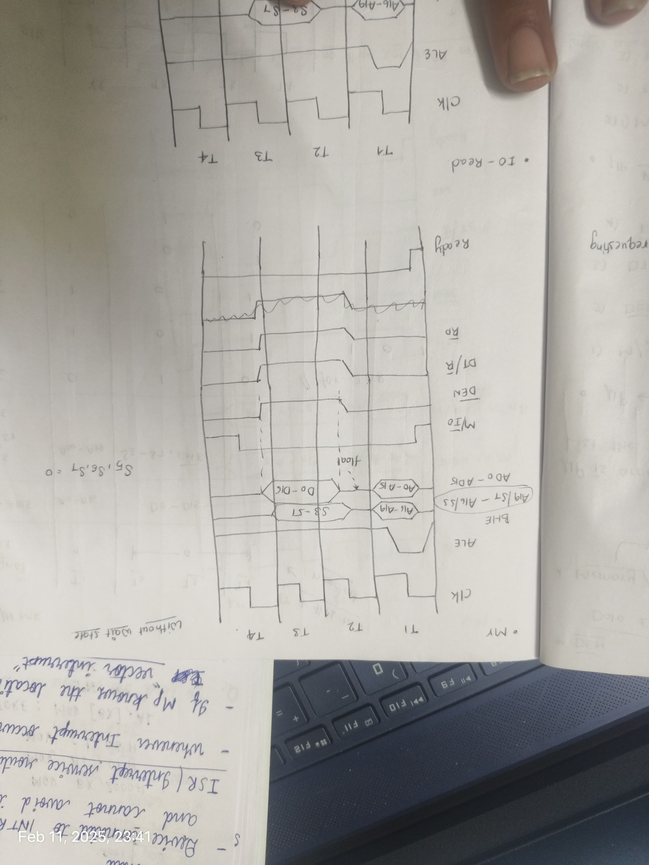
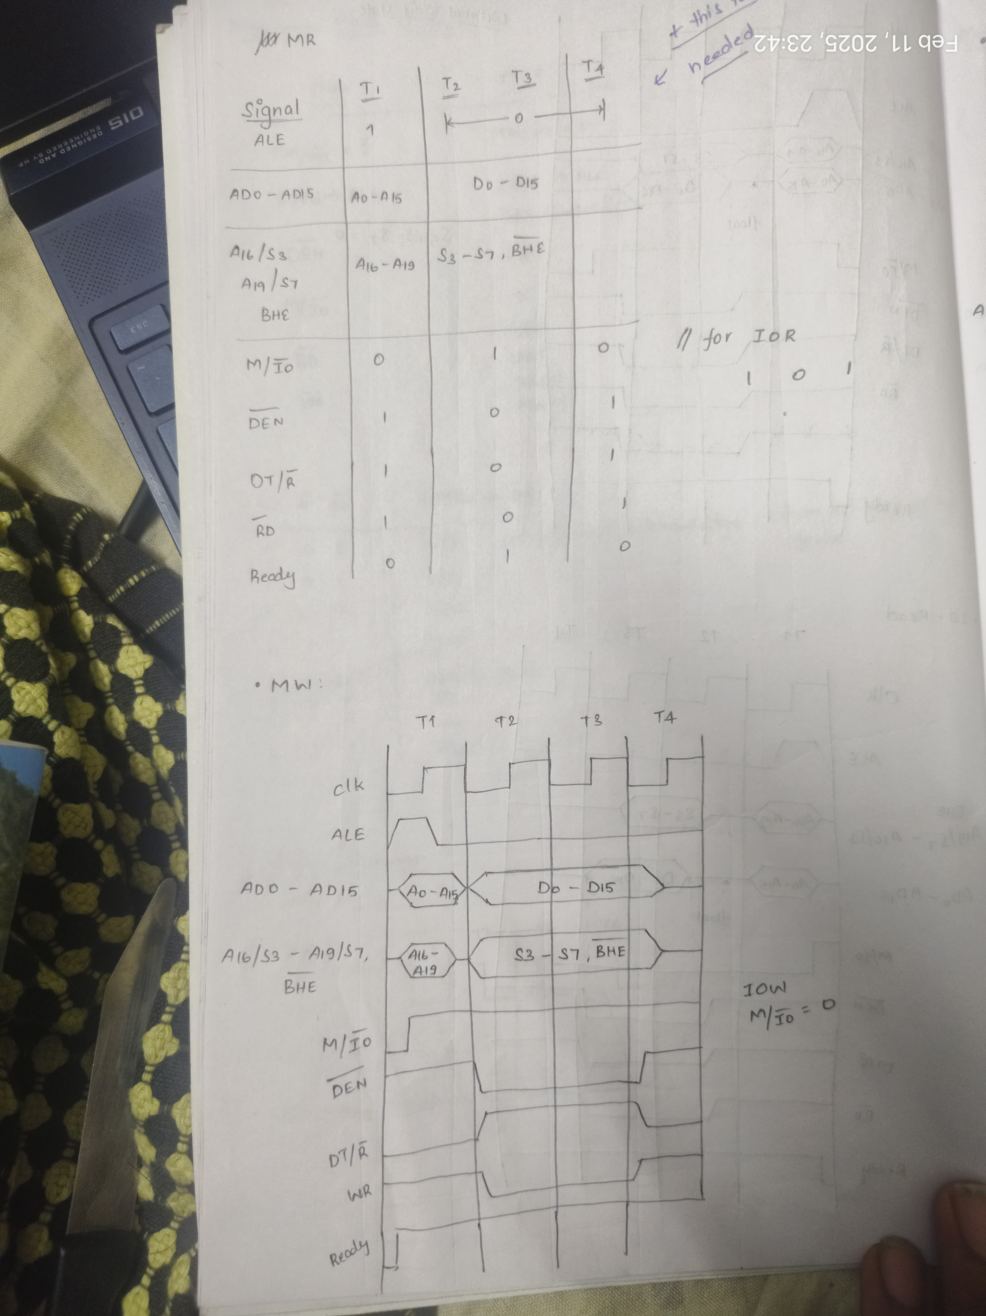
MEMORY READ
MEMORY WRITE

Slide 14
INTERRUPTS

Slide 15
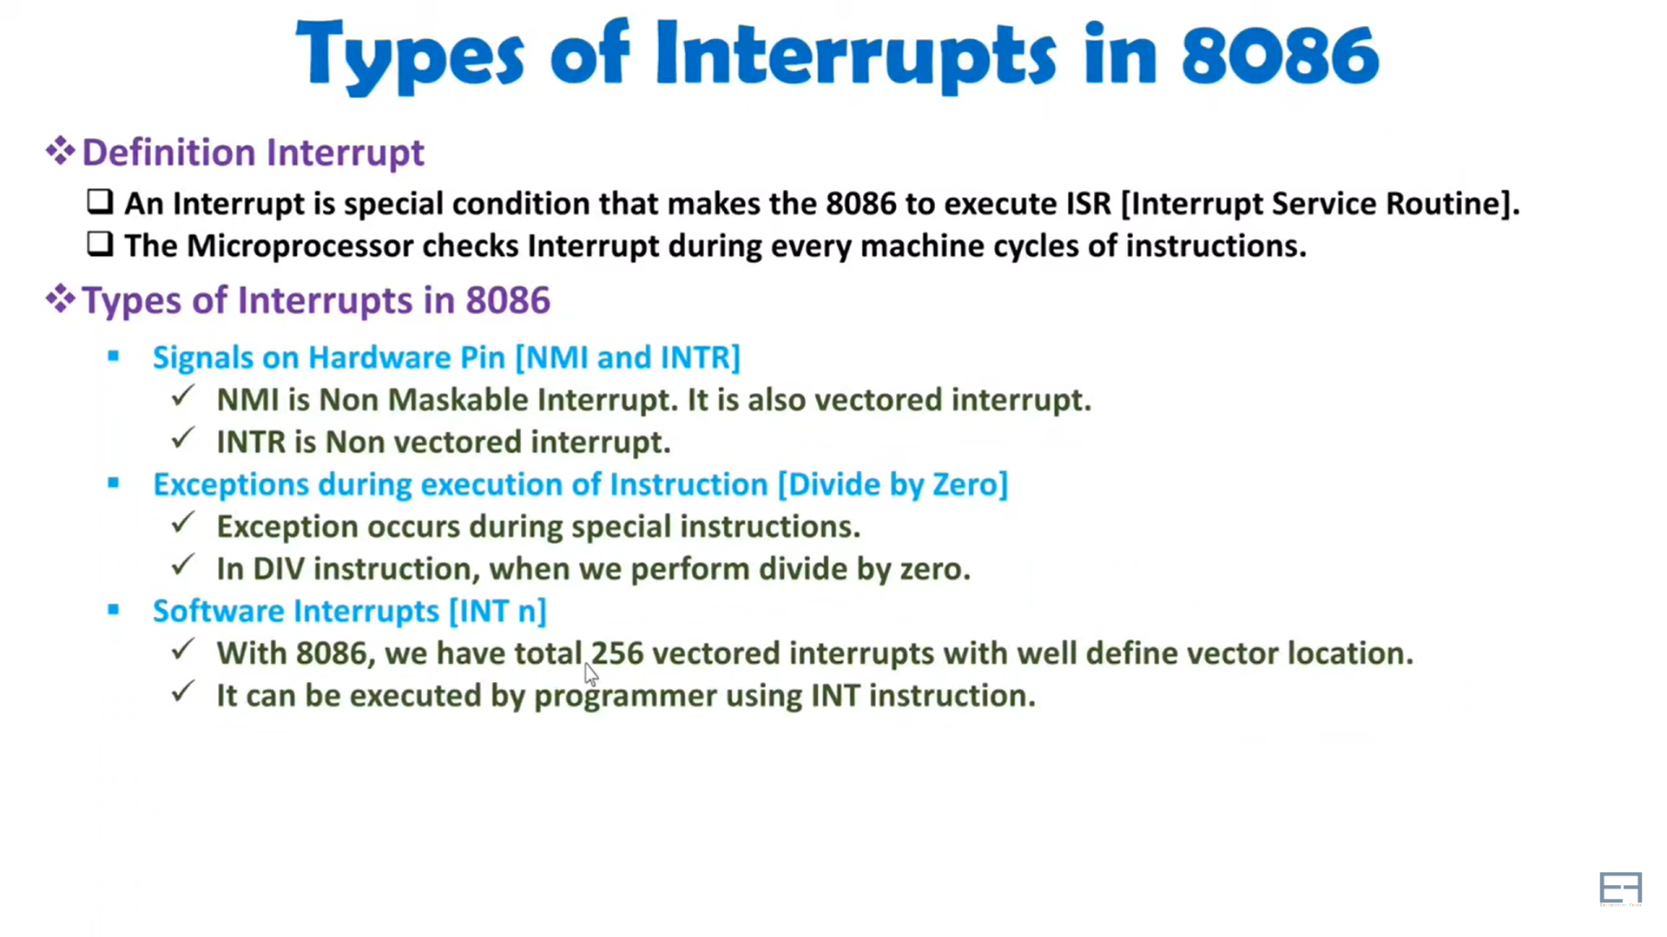

Slide 16
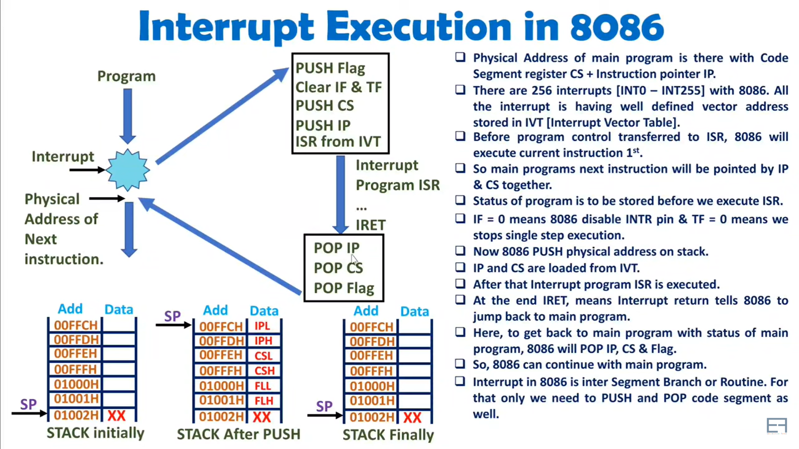

Slide 17
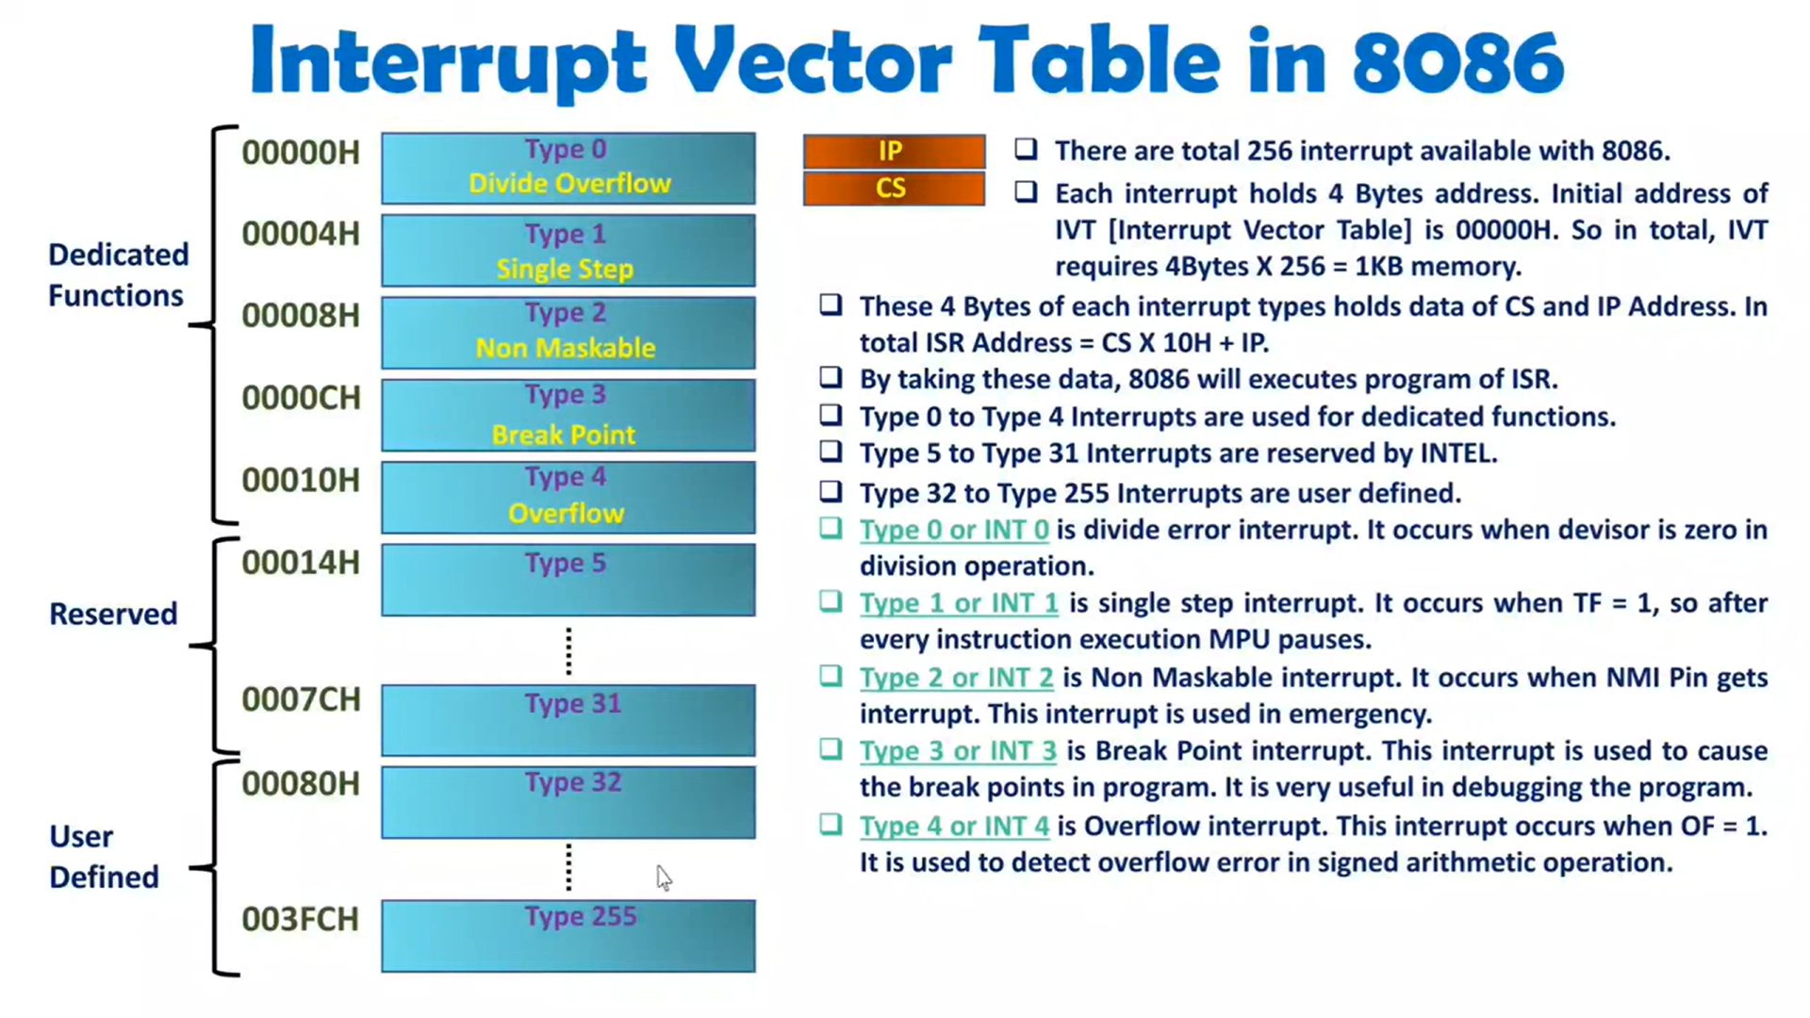

Slide 19
RISC DESIGN PHILOSOPHY
RISC is a design philosophy aimed at delivering simple but powerful instructions that execute within a single cycle at a high clock speed
RISC philosophy is implemented with four major design rules
Instructions — RISC processors have a reduced number of instruction classes.
These classes provide simple operations that can each execute in
single cycle
Pipelines — The processing of instructions is broken down into smaller units that can be executed in parallel by pipelines
Registers — RISC machines have a large general-purpose register set. Any register can contain either data or an address
Load-store architecture — The processor operates on data held in registers.
Separate load and store instructions transfer data between the register bank and external memory

Slide 20
ARM DESIGN PHILOSOPHY
ARM processor has been speciﬁcally designed to be small to reduce power consumption and extend battery operation
Single-chip solution, the smaller the area used by the embedded processor, more available space for specialized peripherals.
High code density
Incorporated hardware debug technology
ARM core is not a pure RISC architecture because instruction set differs from the pure RISC
Variable cycle execution for certain instructions
Inline barrel shifter leading to more complex instructions
Thumb 16-bit instruction set
Enhanced instructions (DSP Functions)

